Slide 1
Semantic Segmentation Capstone Project
PASCALVOC DATASET

Slide 2
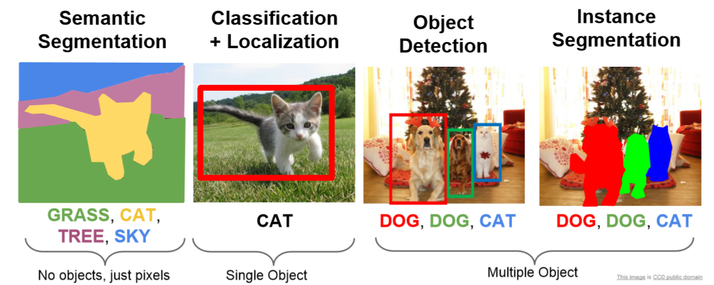
Semantic Segmentation

Slide 3
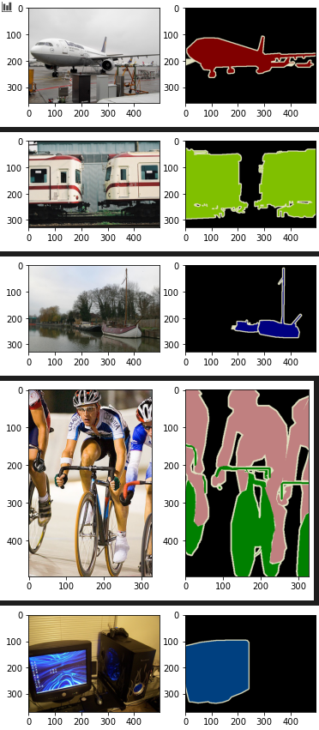
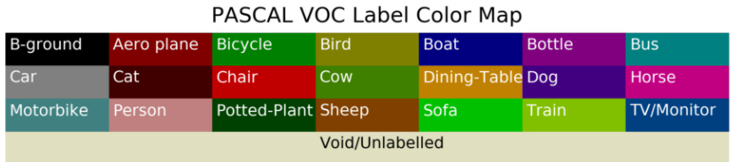
Dataset
Pascal Dataset:
2007: 209 train, 213 val
2008:…
2012: 1000 train, 1000 val

Slide 4
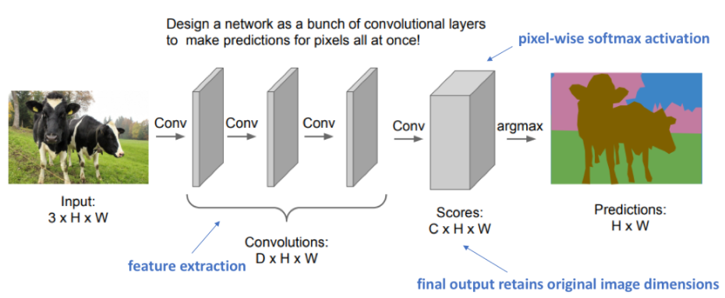
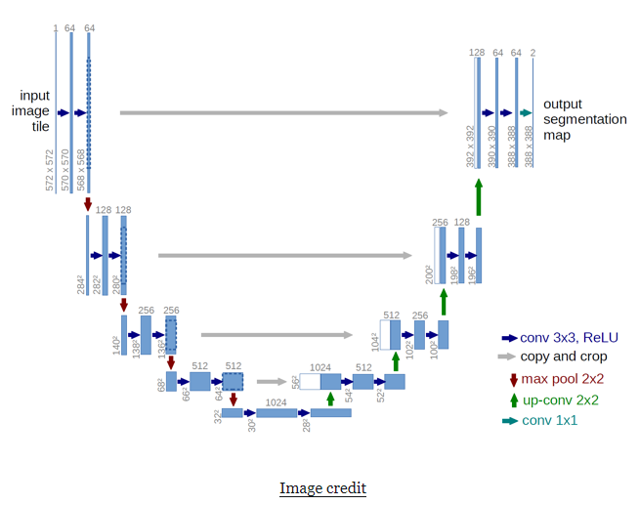
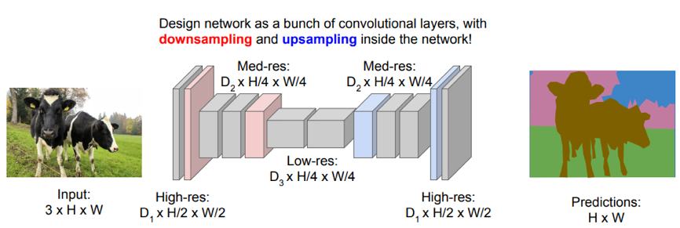
Approaches
Fully Convolutional
U-Net
Down-Upsampling

Slide 5
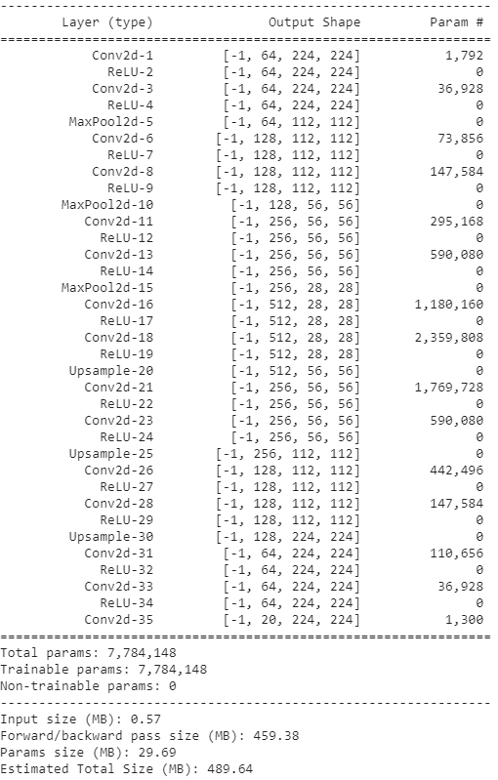
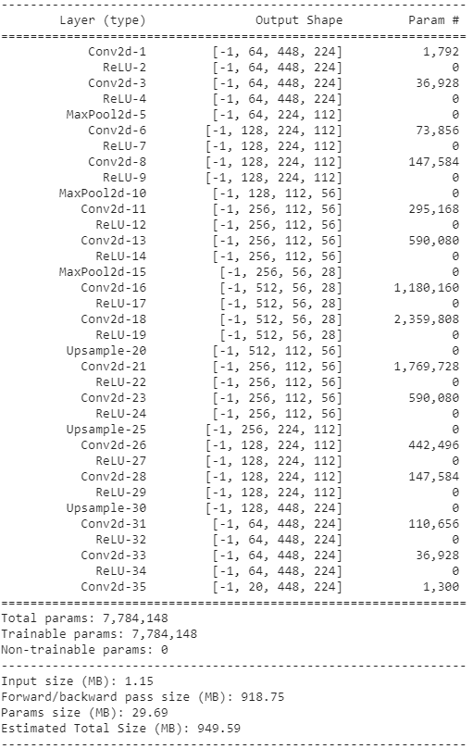
Input size

Slide 6
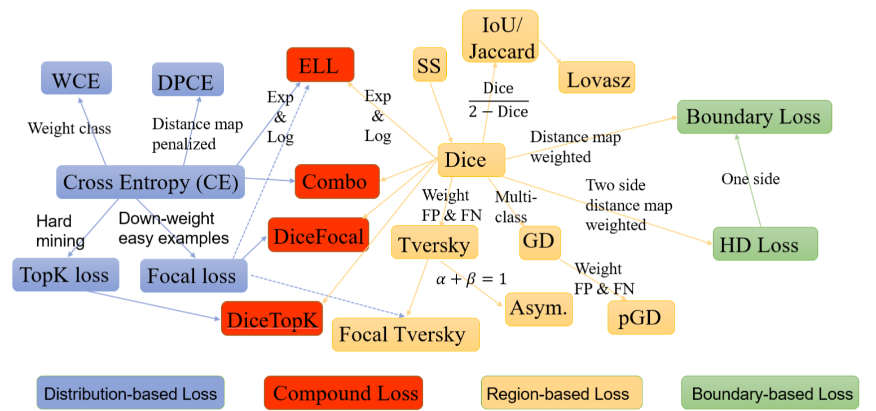
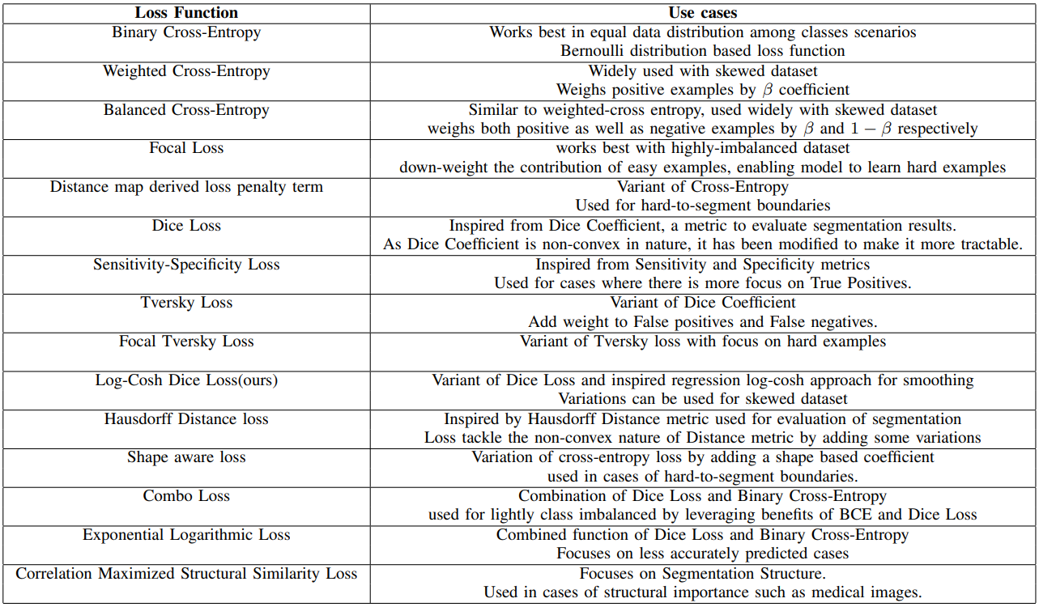
Loss

